Slide 1
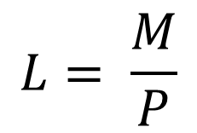
i
L_{s}
5%
L_{D}
$$L= \frac{M}{P}$$

Slide 2

$$\frac{1}{e}$$
O$
D$

